Slide 1

WAY TO ENTERPRISE
AWS
VTI ACADEMY
Author: duy.nguyenngoc1@vti.com.vn

Slide 2
Kinesis Service
A service that allows collect, process, analyze streaming data in real-time
Real-time data such as
  Application logs
  Real-time metrics & reporting
  Stock data, Social network data, Game Data
  Geospatial data (Grab, Uber)
  IoT telemetry data
Support large data, coming continuously, Kinesis is better than SQS

Slide 3
Kinesis Service
3 types
  Kinesis Data Streams: Capture, process, store data streams from multiple sources
  Kinesis Data Firehose: load data streams into data stores
  Kinesis Data Analytics: Perform real-time analytics on Kinesis Streams using SQL
Tutorial: https://docs.aws.amazon.com/kinesis/index.html

Slide 4
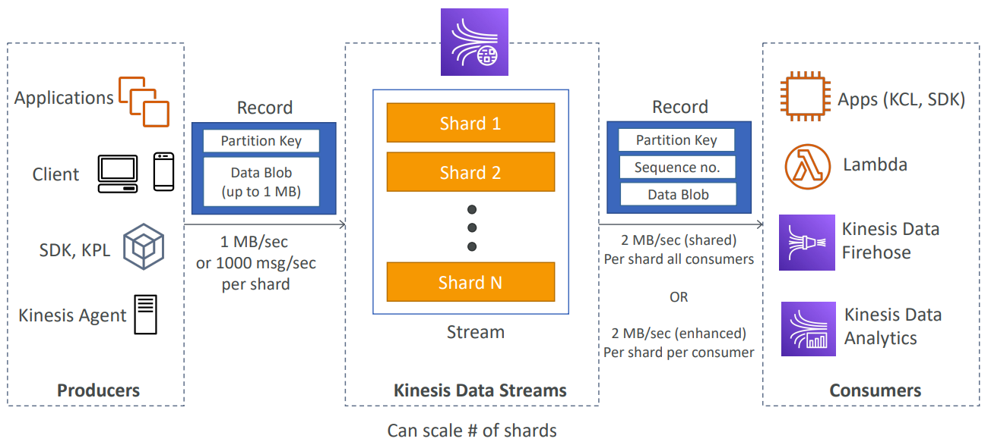
Kinesis Service
Kinesis Data Streams
  Capture, process, store data streams from multiple sources

Slide 5
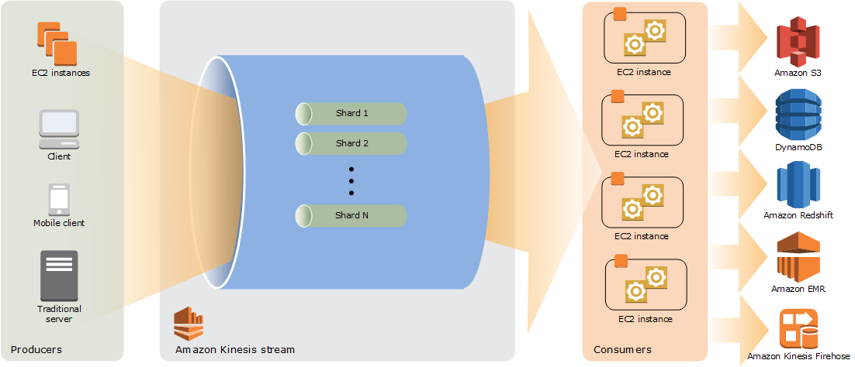
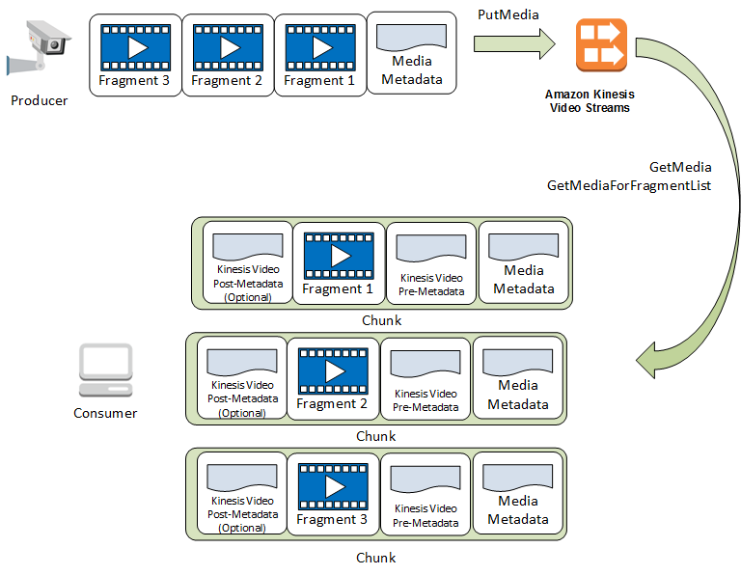
Kinesis Service
  Data will be saved on Kinesis
  Data must be handled manually through applications on EC2

Slide 6
Kinesis Service
  Demo
    https://drive.google.com/open?id=1AkfXEaAFENd1scGK_VOAuaHgL7XuQZ9S

Slide 7
Assignment
  Self-practice

Slide 8
Kinesis Service
  Components
    Data stream
    Kinesis data stream
    Producer
    Consumer

Slide 9
Kinesis Service
    Data stream
      Application logs
      Real-time metrics & reporting
      Stock data, Social network data, Game Data
      Geospatial data (Grab, Uber)
      IoT telemetry data, …

Slide 10
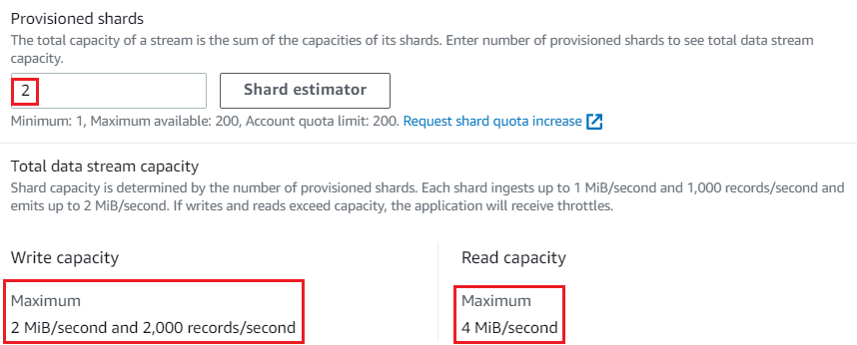
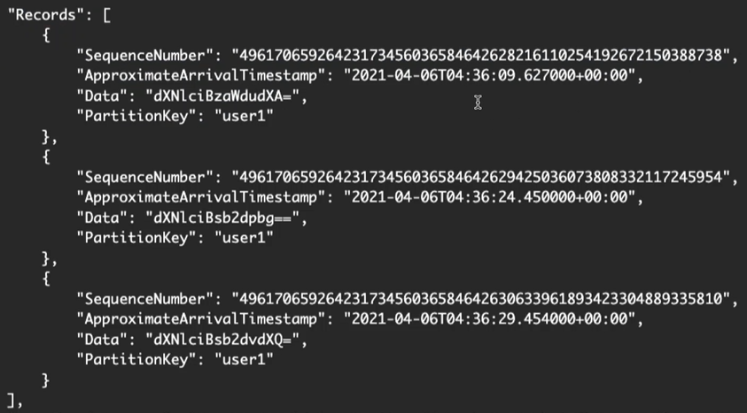
Kinesis Service
    Kinesis data stream
      Shard
        Including records
        Max: 200 shard, 1 MiB/second, 1000 records/second
      Record
        Including Sequence Number - Record ID, Partition Key - Shard Id, Data Blob (max 1MB)
        Once data is inserted in Kinesis, it can’t be deleted (immutability)
      Retention Period: Is the time to save data on kinesis, max 365 days
      Encryption: At-rest (KMS)

Slide 11
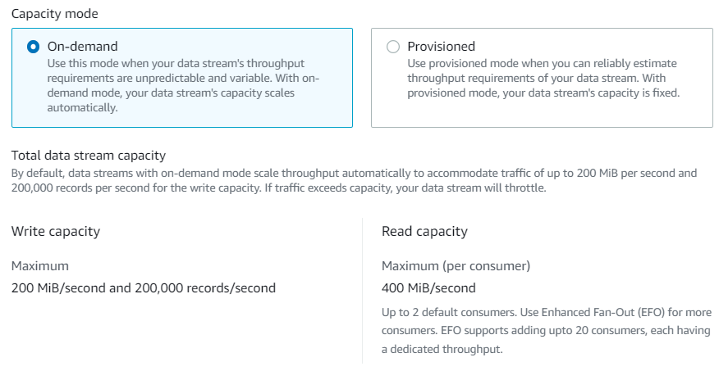
Kinesis Service
      2 capacity modes: On-demand, Provisioned

Slide 12
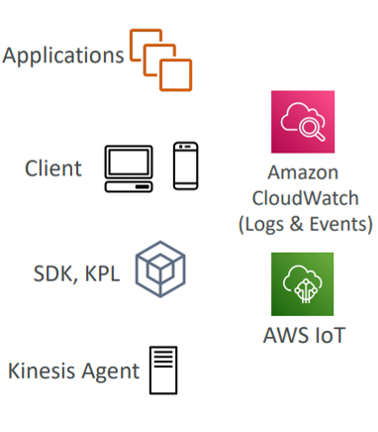
Kinesis Service
    Producer
      Is data sources (Ex: Camera, smartphone, webcam, audio recording devices, IOT devices generate data, Application run on EC2, ...)
      Support SDK, Kinesis Producer Library (KPL), Kinesis Agent
    Consumer
      Is a source of consume data after Kinesis processes it
      Ex: Applications run on EC2, Lambda Function, Kinesis Data Firehose, Kinesis Data Analytics, ...
Producer

Slide 13
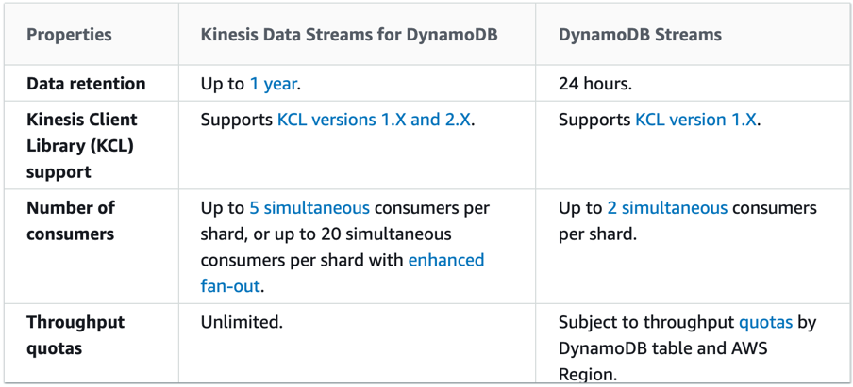
Kinesis Service
Kinesis Data Stream & DynamoDB Stream Comparing
https://docs.aws.amazon.com/amazondynamodb/latest/developerguide/streamsmain.html#streamsmain.choose

Slide 14
Assignment
  Self-practice

Slide 15
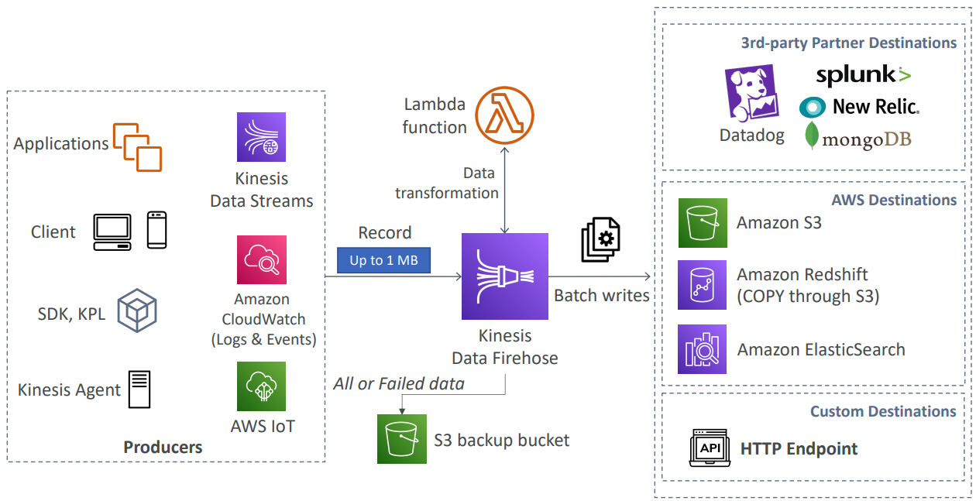
Kinesis Service
Kinesis Data Firehose
  Load data streams into data stores
  Data is not stored in kinesis
  Data is transferred to other data stores (Similar to an intermediary)
  No administration, automatic scaling, serverless
  Data don’t need handled manually through applications on EC2
  Near Real Time: 60 seconds latency minimum for non full batches or minimum 32 MB of data at a time

Slide 16
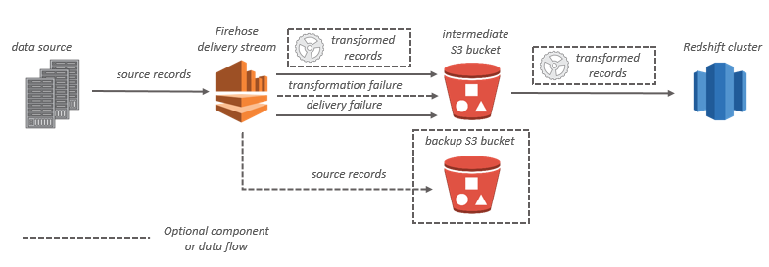
Kinesis Service
  Supports many data formats, conversions, transformations, compression
  Supports custom data transformations using AWS Lambda
  Can send failed or all data to a backup S3 bucket

Slide 17
Kinesis Service
  Demo
    https://drive.google.com/open?id=1Akwy_ECPNAhR2Bvp5dE1hPlWptSqUW-o

Slide 18
Assignment
  Self-practice

Slide 19
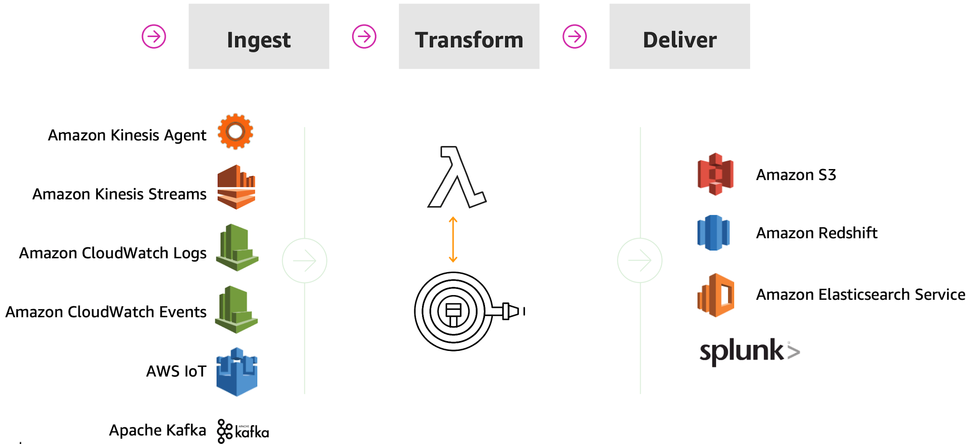
Kinesis Service
  Components
    Producer
    Consumer
    Lambda Function

Slide 20
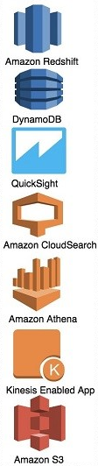
Kinesis Service
    Producer
      Is data sources (Ex: Camera, smartphone, webcam, audio recording devices, Application run on EC2, ...)
      Kinesis Data Stream
      Support SDK, Kinesis Producer Library (KPL), Kinesis Agent
    Consumer
      Is a source of consume data after Kinesis processes it
      Ex: AWS Service (S3, RedShift, DynamoDB, ...), HTTP Endpoint, ...
Producer
Consumer

Slide 21
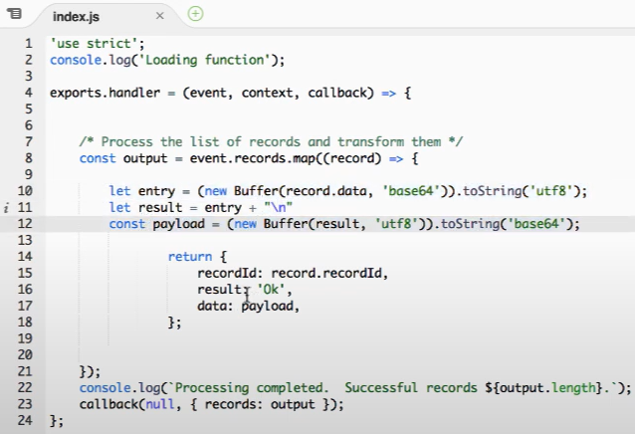
Kinesis Service
    Lambda Function (Optional)
      Using for transform data
Tutorial: https://www.youtube.com/watch?v=wRGd2G82Opo

Slide 22
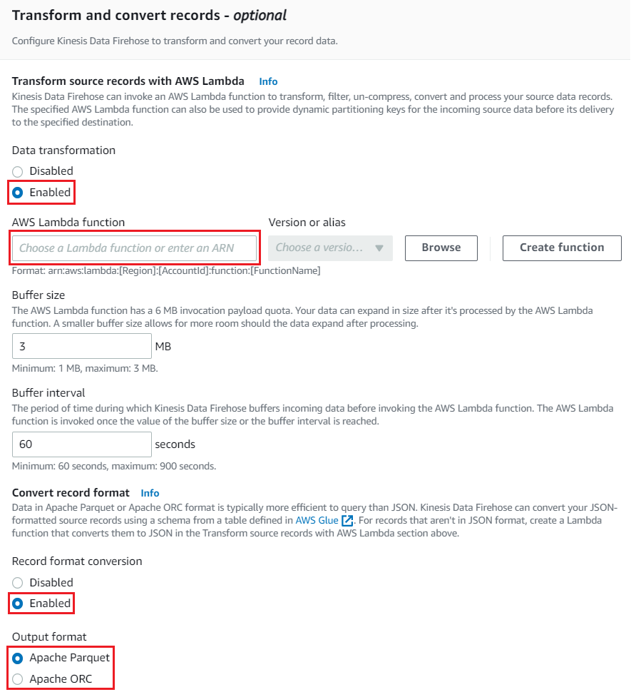
Kinesis Service
  Features
    Transform & convert format of record via Lambda Function
    Data Compression
    Monitoring via CloudWatch
    Encryption
    IAM Role

Slide 23
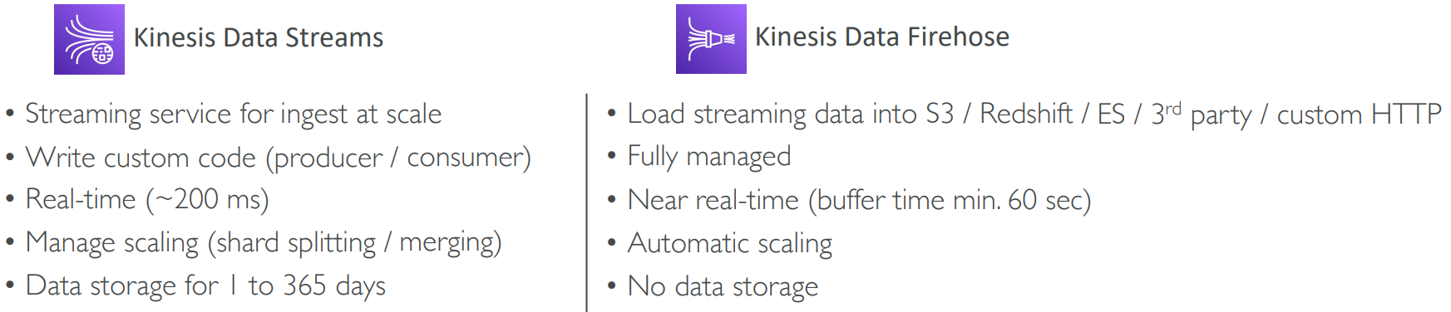
Kinesis Service
Kinesis Data Stream & Kinesis Data Firehose Comparing

Slide 24
Assignment
  Self-practice

Slide 25
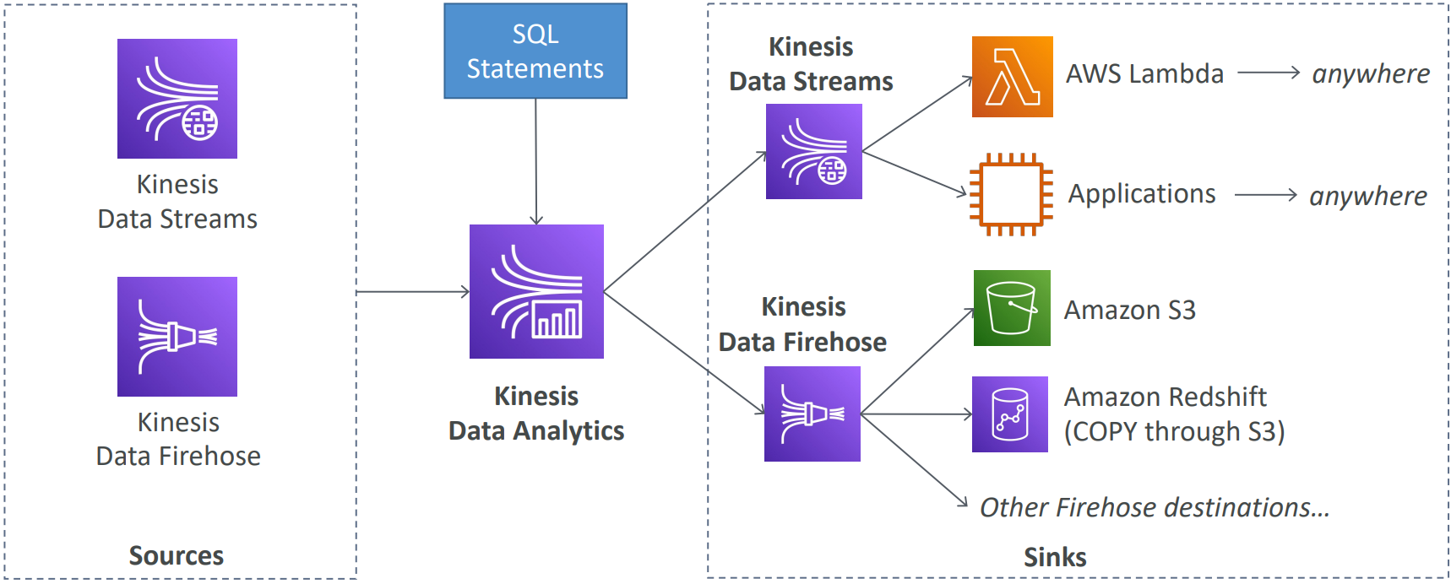
Kinesis Service
Kinesis Data Analytics
  Perform real-time analytics on Kinesis Streams using SQL
  No administration, automatic scaling, serverless
  Use cases: Generate Time-series analytics, Real-time dashboards, Create Real-time metrics

Slide 26
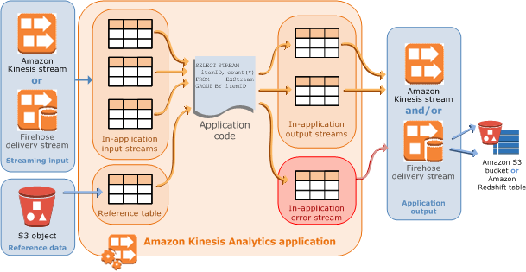
Kinesis Service
  Flow
https://docs.aws.amazon.com/kinesisanalytics/latest/dev/how-it-works.html

Slide 27
Kinesis Service
  Demo
    https://www.youtube.com/watch?v=m8S8Tow6C3k

Slide 28
Assignment
  Self-practice

Slide 29
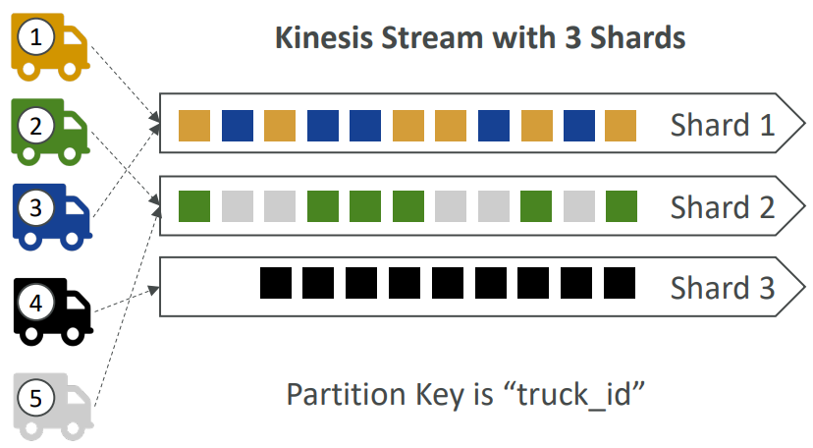
Kinesis Service
Ordering data into Kinesis
  Imagine you have 100 trucks (truck_1, truck_2, … truck_100) on the road sending their GPS positions regularly into AWS.
  You want to consume the data in order for each truck, so that you can track their movement accurately
  How should you send that data into Kinesis?
    Send using a "Partition Key" value of the "truck_id“, The same key will always go to the same shard

Slide 30
Summary
A service that allows collect, process, analyze streaming data in real-time
Real-time data such as: Application logs, Real-time metrics & reporting, Stock data, Social network data, Game Data, Geospatial data (Grab, Uber), IoT telemetry data, ...
Support large data, coming continuously, Kinesis is better than SQS
3 types: Kinesis Data Streams, Kinesis Data Firehose, Kinesis Data Analytics

Slide 31
Summary
Kinesis Data Streams
  Capture, process, store data streams from multiple sources
  Data must be handled manually through applications on EC2
  Data will be saved on Kinesis
  Producer: Support SDK, Kinesis Producer Library (KPL), Kinesis Agent
  Consumer: Applications run on EC2, Lambda Function, Kinesis Data Firehose, Kinesis Data Analytics, ...

Slide 32
Summary
Kinesis Data Firehose
  Load data streams into data stores
  No administration, automatic scaling, serverless
  Data is not stored in kinesis
  Near Real Time
  Supports many data formats, compression, conversions, transformations with Lambda Function
  Producer: Similar to Kinesis Data Stream,
  Consumer: AWS Service (S3, RedShift, DynamoDB, ...), HTTP Endpoint, ...

Slide 33
Summary
Kinesis Data Analytics
  Perform real-time analytics on Kinesis Streams using SQL
  No administration, automatic scaling, serverless
  Use cases: Generate Time-series analytics, Real-time dashboards, Create Real-time metrics

Slide 34
Q & A
Copyright © VTI Academy All Rights Reserved

